Slide 1
Controlling Two Characters Using Reinforcement Learning With Physics
By Julian Lee, 2600433L

Slide 2

Physics-Based Character Animation
Adaptable, accurate
Uses algorithms to simulate real life
Highly Engaging
Merida from the film Brave
Notes:
Brave- 1500 curves, new software program

Slide 3
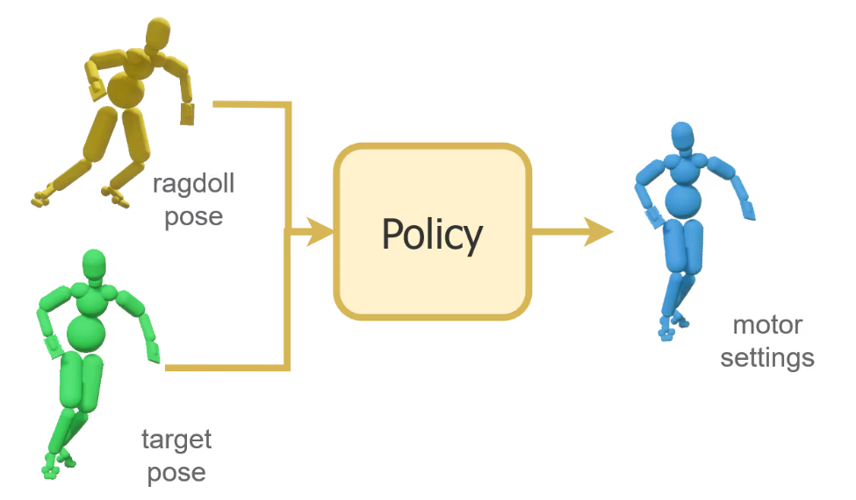
Using Deep Reinforcement Learning
Sourced from Ubisoft Supertrack
Notes:
Ragdoll – Character as it is
Target – Motion
Train the ragdoll to keep on the target, policy is created.
Talk about noise and adaptability

Slide 4
DeepMimic
One of the earlier implementations
Open-sourced, has wide user-base
Uses policies to learn movement
Not able to simulate and train multiple characters
A unique format for a humanoid

Slide 5
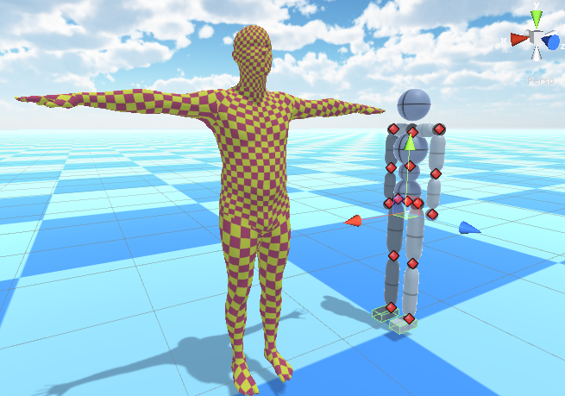
Conversion of Datasets
More Datasets means more reliable data
Conversion is hard
CHI3D – a dataset for multiple people interacting
Skeletons aren’t always compatible
Sourced from Zju George in a DeepMimic issue

Slide 6
The bottleneck
Dive into the source code
Inheritance of classes
Relevant functions finally revealed
Argument files

Slide 7
Solution
Alter source code such that multiple characters can interact
Train two policies on two characters performing actions individually
Train a policy with them interacting with each other
The Result?

Slide 8
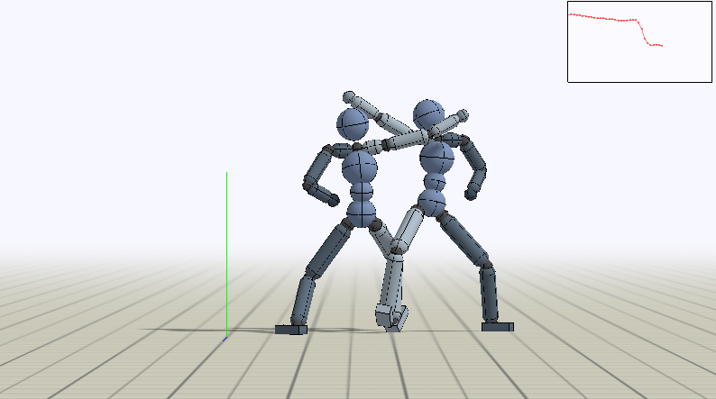
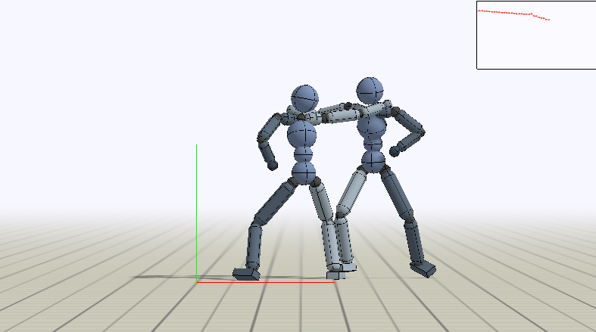
Evaluation and Final Remarks
The Two Characters Who Trained Separately
Those That Trained Together

